Slide 1
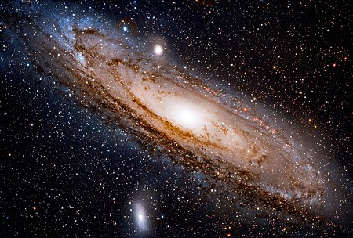
BLACK HOLE
PRESENTED BY-
DEVANSHI KARMA
B.TECH (CSE)
SECTION-D
ROLL NO.16
GUIDED BY-
DR. ANJANA SEKHAR

Slide 2
INDEX
1.INTODUCTION TO BLACK HOLE
2.WHAT ARE BLACK HOLE ?
3.HOW ARE BLACK HOLE CREATED?
4.TYPES OF BLACK HOLE
5.PARTS OF BLACK HOLE
6.SPAGUETTIIFICATION
7.FALLING INTO BLACK HOLE

Slide 3
1.INTRODUCTION
The first time the idea of a black hole was suggested was in the late 1970’s by John michell of England and pierre-simon laplace of France . They both proposed the idea of the existence of an “Invisible star “ by applying the first Newton law . They calculated its mass and size , which is now called the ” event horizon” that an object would needed in order to be faster than even the speed of light . Later ,in 1915, Einstein predicted the existence of black hole with his general relativity theory .After that , in 1967,John Wheeler , an American theoretical physicist , applied the term of black hole to what it means now.

Slide 4
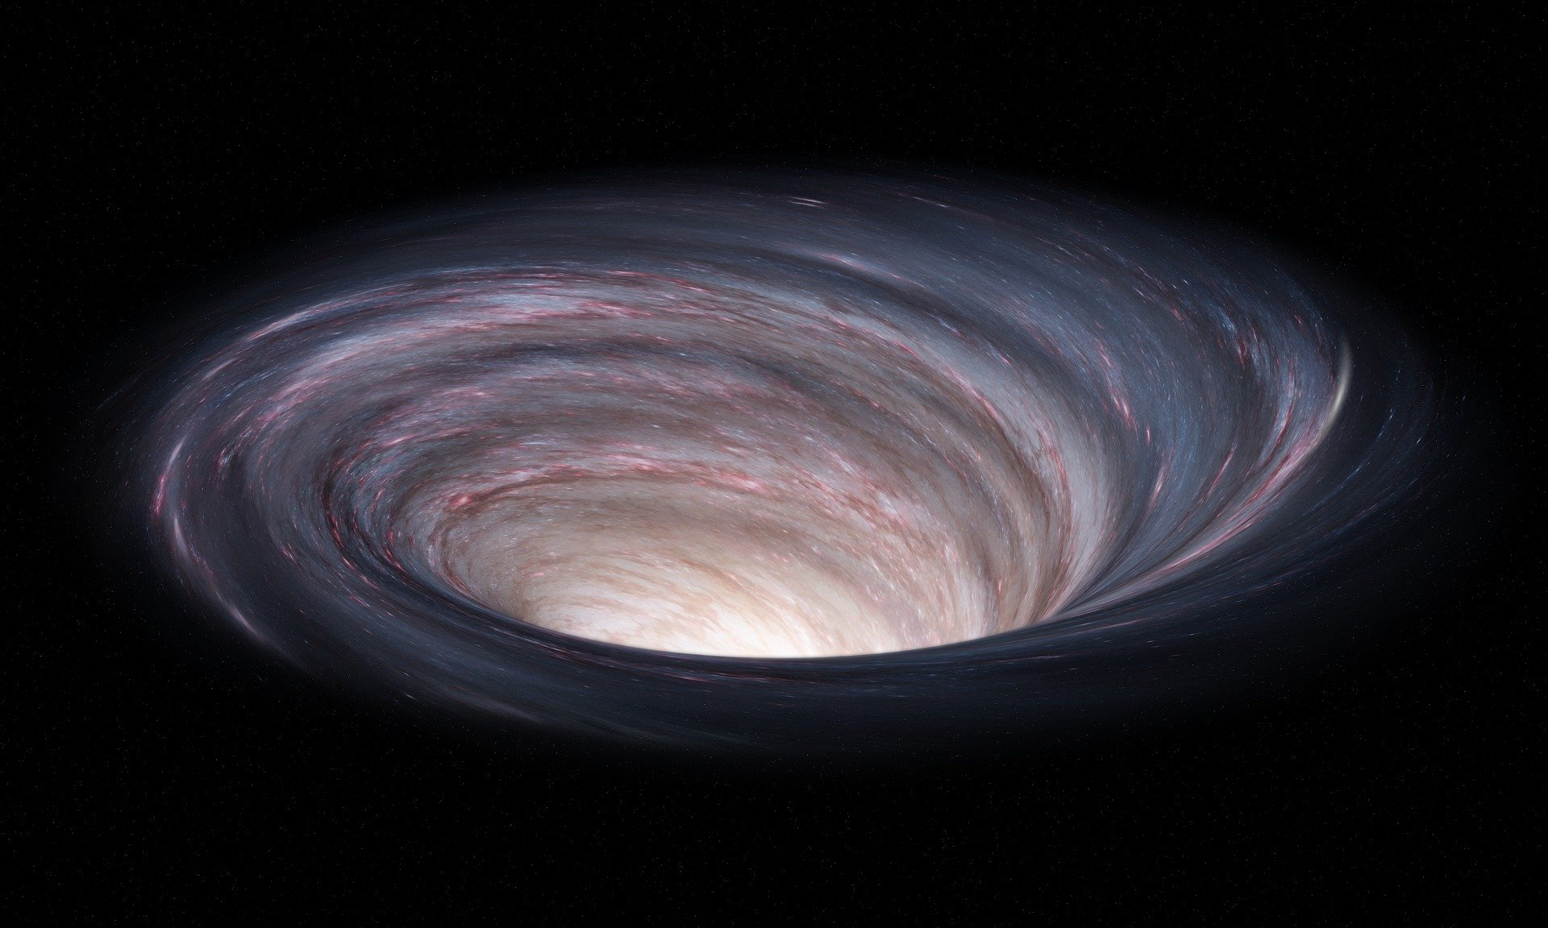
2.WHAT ARE BLACK HOLE ?
A black hole is a place in space where gravity pulls so much that even light can not get out. The gravity is so strong because matter has been squeezed into a tiny space. This can happen when a star is dying. Because no light can get out, people can't see black holes. They are invisible.

Slide 5
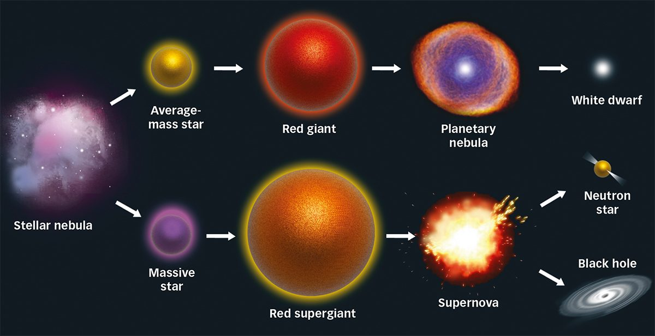
3.How Black Hole is Created
A Common type of black hole is created by the dying stars
For most of the stars life is balanced by gravity and pulling pressure
When the nuclear fuel is ended the star shrinks and hence black hole is created
White dwarf
Supernova
Zero volume
singularity

Slide 6
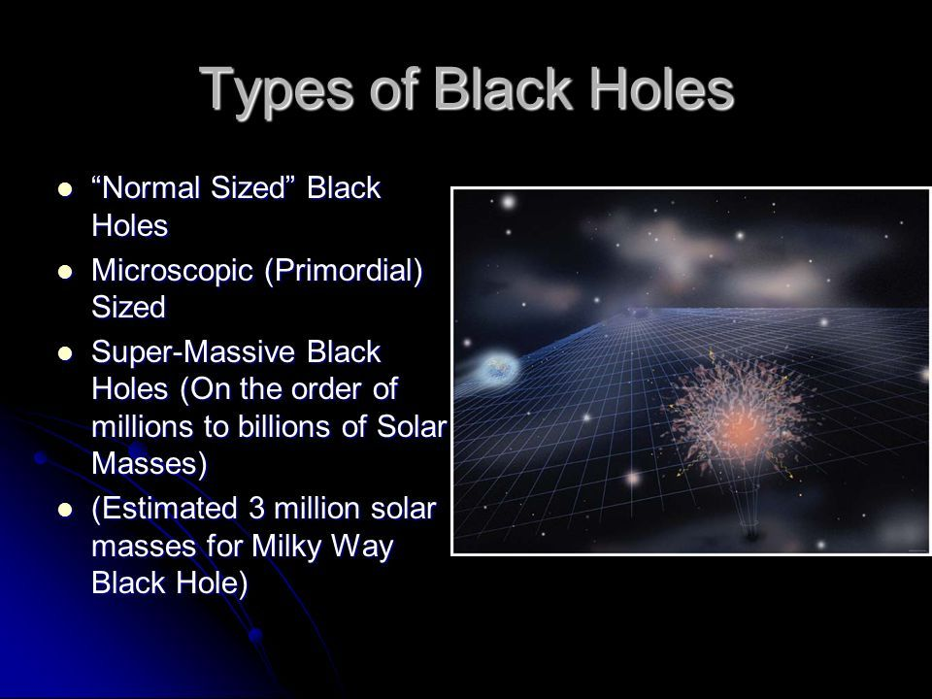

Slide 7
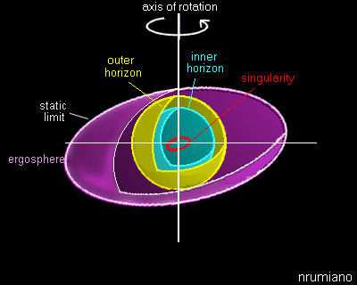
PARTS OF A
BLACK HOLE
A black hole has 6 parts. It has an axis of rotation that makes it spin. The static limit is on the outside.
The ergosphere is after the static limit. Next comes the outer and inner horizons, and last is the singularity, which is in the center.

Slide 8
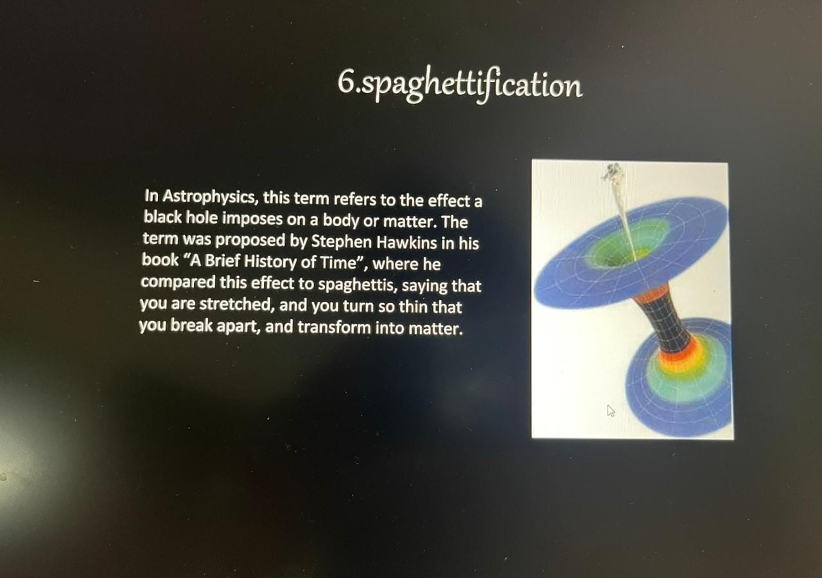

Slide 9
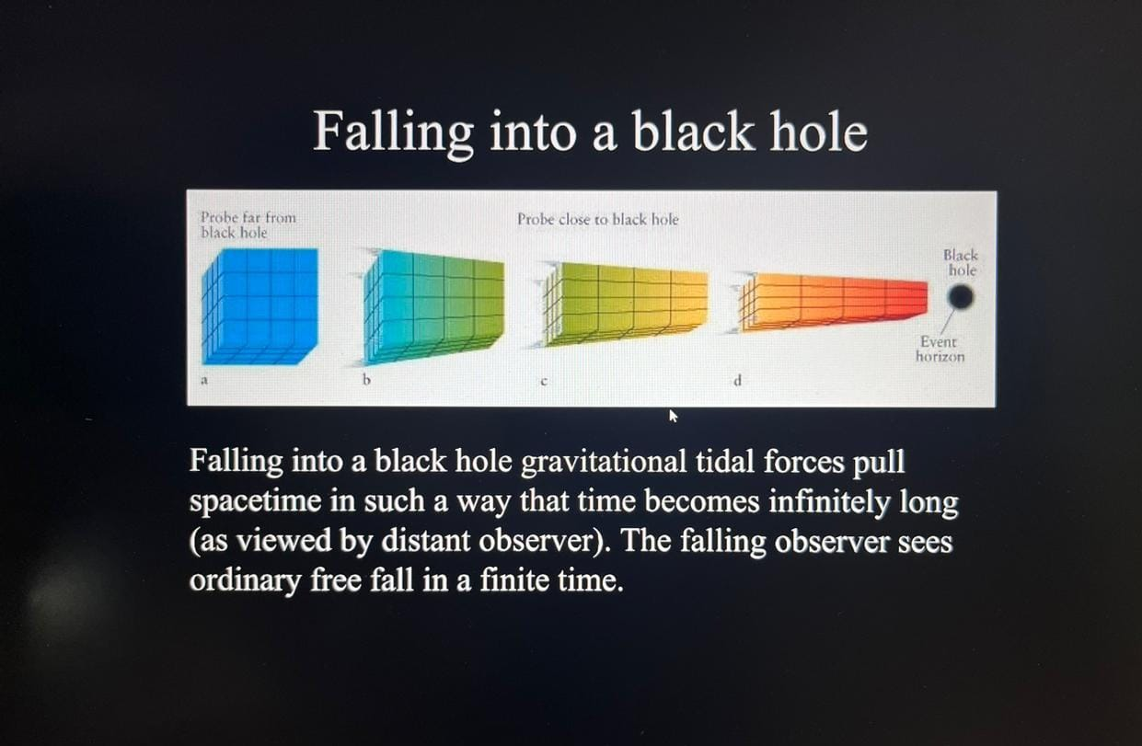

Slide 10
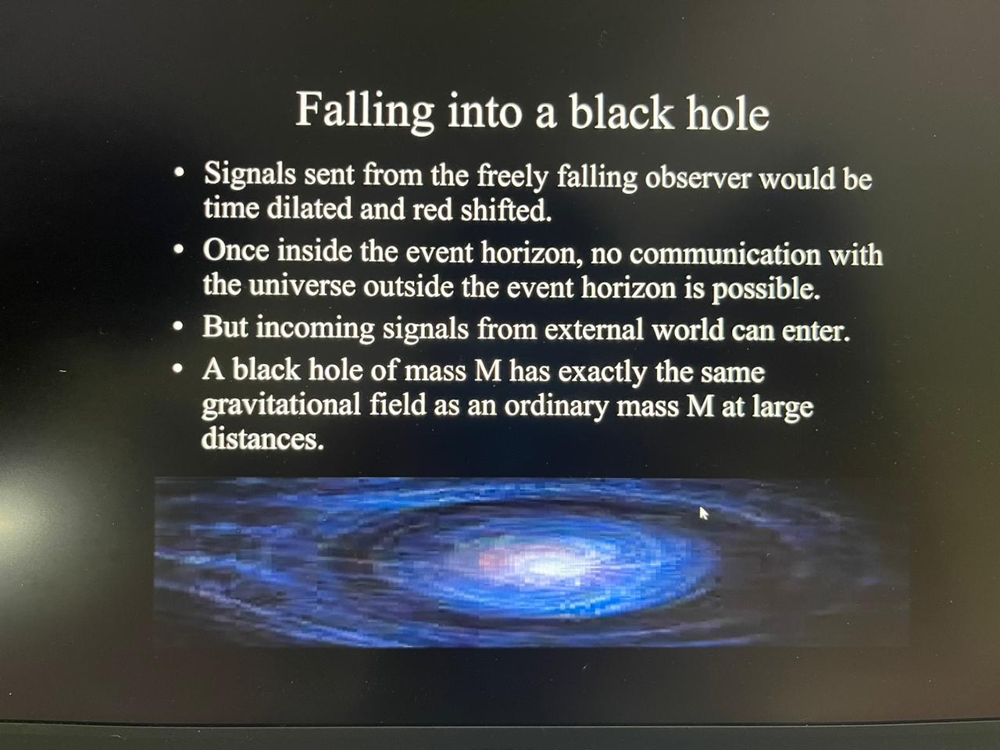

Slide 11
THANK YOU

